Slide 1

Introductory Statistics
Introductory Statistics

Slide 2
Inference for One Mean, σ unknown
The t distribution
Hypothesis Testing
Confidence Intervals
Checking Requirements

Slide 3
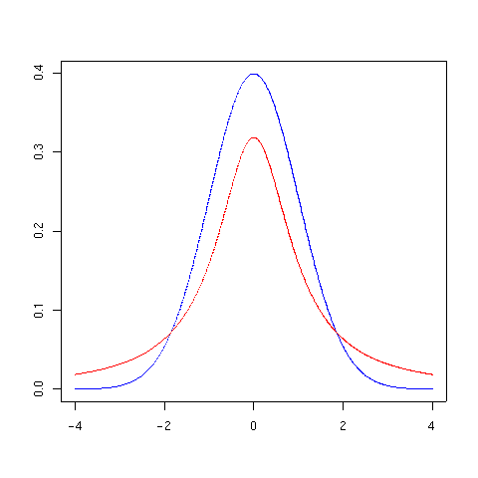

Z distribution
T distribution
1 degree of freedom
Use the t distribution when we don’t know the population standard deviation
T – Distribution’s tails are thicker
Fewer data at the center
T – Distribution becomes standard Z as n (sample size) gets larger

Slide 4
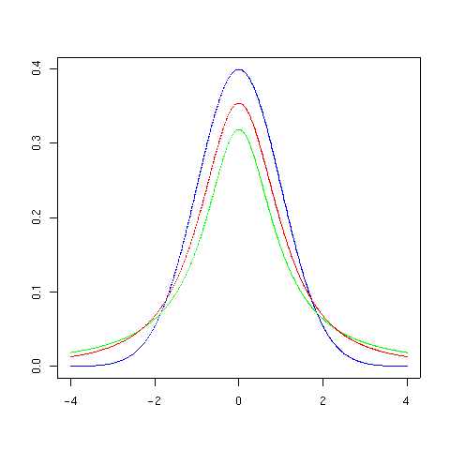
2 degrees of freedom

Slide 5
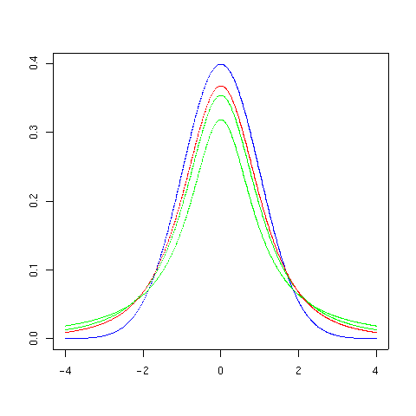
3 degrees of freedom

Slide 6
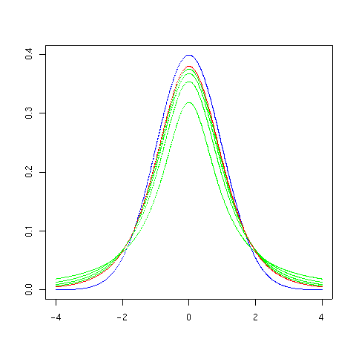
5 degrees of freedom

Slide 7
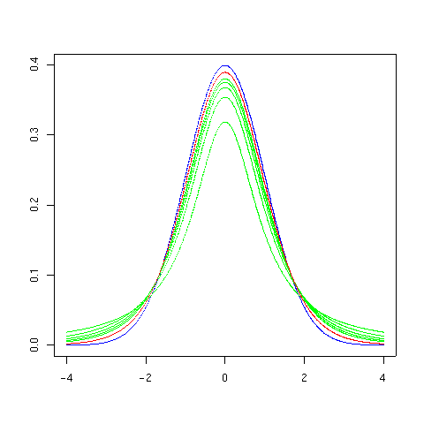
10 degrees of freedom

Slide 8
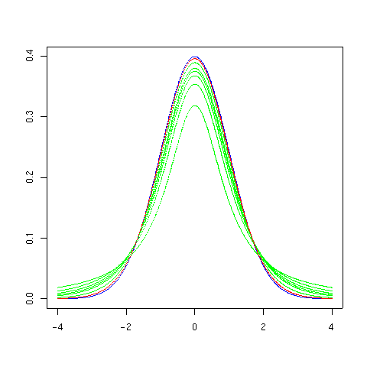
30 degrees of freedom

Slide 9
Inference for One Mean, σ unknown
The t distribution
Hypothesis Testing
Confidence Intervals
Checking Requirements

Slide 10

Steps to Hypothesis Testing – σ known
State the null and alternative hypotheses
Determine the level of significance (α) – mostly given to you in this class
Compute the Test Statistic:
Determine P-Value based on Test Statistic.
Use the applet.
Decision Rule - Reject the Null Hypothesis if the P-value is less than the level of significance (α), if not then don’t reject.
State the conclusion (in layman’s terms)
If Reject H_{o} – We have sufficient evidence to say that “state H_{a} in Plain English”
If Don’t Reject H_{o} - We have insufficient evidence to say that “state H_{a} in Plain English”
How realistic is the σ being known?

Slide 11

Steps to Hypothesis Testing – σ unknown
State the null and alternative hypothesis
Determine the level of significance (α) – mostly given to you in this class
Do Steps 2-4 with Software (Excel or SPSS)
Compute the Test Statistic:
Determine the Degrees of Freedom (n-1)
Determine P-Value.
Decision Rule - Reject the Null Hypothesis if the P-value is less than the level of significance (α), if not then don’t reject.
State the conclusion
If Reject H_{o} – We have sufficient evidence to say that “state H_{a} in Plain English”
If Don’t Reject H_{o} - We have insufficient evidence to say that “state H_{a} in Plain English”

Slide 12
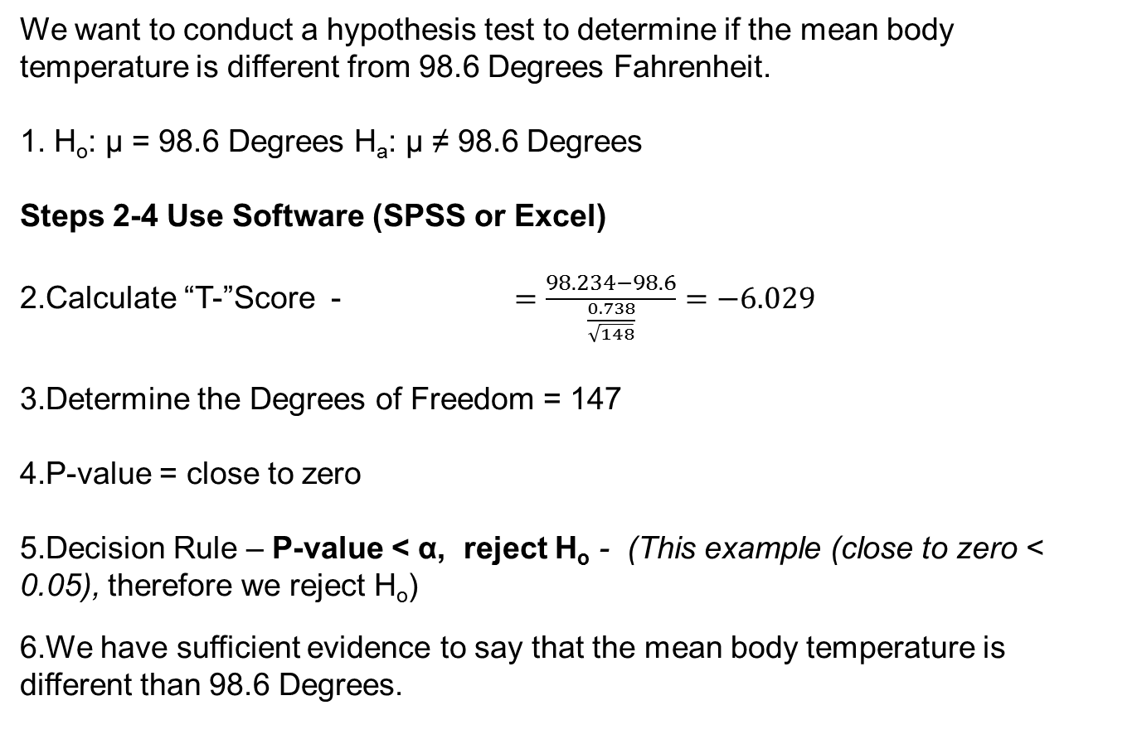
Hypothesis Test (σ unknown) – One Sample (Example)
We want to conduct a hypothesis test to determine if the mean body temperature is different from 98.6 Degrees Fahrenheit.
H_{o}: µ = 98.6 Degrees H_{a}: µ ≠ 98.6 Degrees
Steps 2-4 Use Software (SPSS or Excel)
Calculate “T-”Score - $=\frac{98.234−98.6}{\frac{0.738}{\sqrt{148}}}=−6.029$
Determine the Degrees of Freedom = 147
P-value = close to zero
Decision Rule – P-value < α, reject H_{o} - (This example (close to zero < 0.05), therefore we reject H_{o})
We have sufficient evidence to say that the mean body temperature is different than 98.6 Degrees.

Slide 13
Hypothesis Test (σ unknown) – One Sample (Example)
The birth weight of a child is an important indicator of their neonatal health. It is important that pediatric health care providers track changes in the birth weights over time. The birth weight of children in Australia has historically had a population mean of 3373 grams. Is this still the mean birth weight of Australian children, or has there been a decrease? We will use the 0.05 level of significance.
H_{o}: µ = 3373 grams H_{a}: µ < 3373 grams
Steps 2-4 Use Software (Excel or SPSS)
Calculate “T-”Score - = -1.219
Determine the Degrees of Freedom = 43
P-value = 0.114
Decision Rule – P-value > α, we don’t reject H_{o} - (This example (0.114 > 0.05), therefore we don’t reject H_{o})
We have insufficient evidence to say that the mean birth weight of Australian children has decreased from 3373 grams.

Slide 14
Inference for One Mean, σ unknown
The t distribution
Hypothesis Testing
Confidence Intervals
Checking Requirements

Slide 15
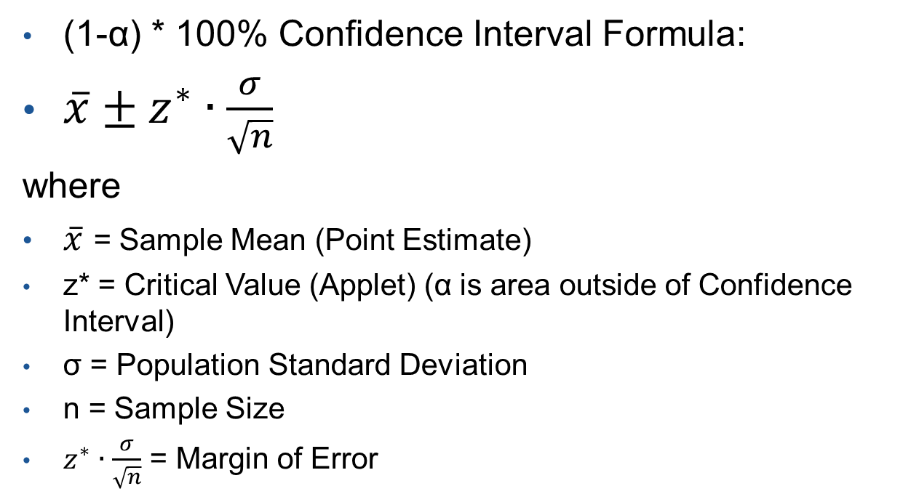
Confidence Interval (σ known)
(1-α) * 100% Confidence Interval Formula:
$\overline{x}±z^{∗}∙\frac{σ}{\sqrt{n}}$
where
$\overline{x}$ = Sample Mean (Point Estimate)
z* = Critical Value (Applet) (α is area outside of Confidence Interval)
σ = Population Standard Deviation
n = Sample Size
$z^{∗}∙\frac{σ}{\sqrt{n}}$ = Margin of Error
How realistic is the σ being known?

Slide 16
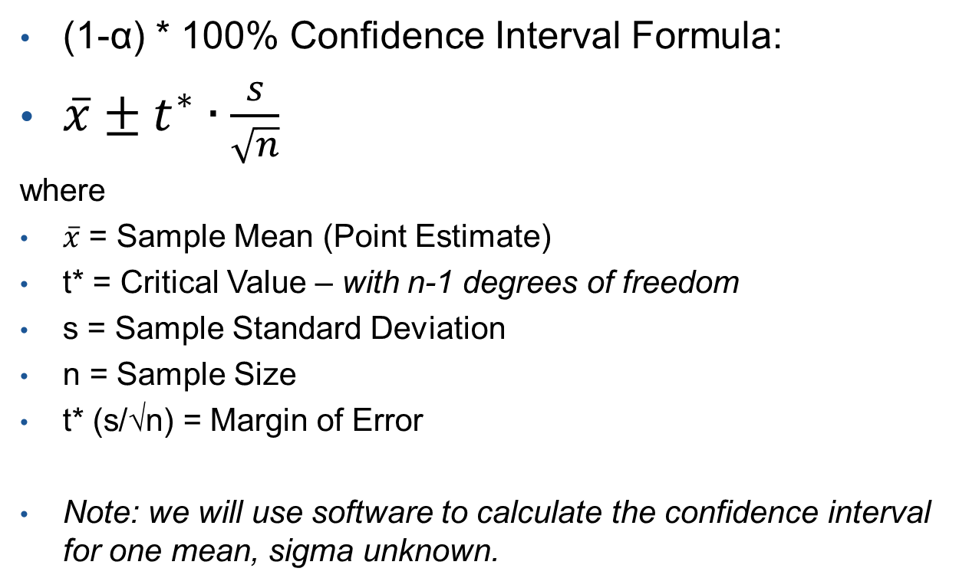
Confidence Interval (σ unknown)
(1-α) * 100% Confidence Interval Formula:
$\overline{x}±t^{∗}∙\frac{s}{\sqrt{n}}$
where
$\overline{x}$ = Sample Mean (Point Estimate)
t* = Critical Value – with n-1 degrees of freedom
s = Sample Standard Deviation
n = Sample Size
t* (s/√n) = Margin of Error
Note: we will use software to calculate the confidence interval for one mean, sigma unknown.

Slide 17
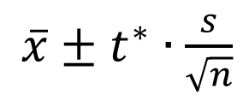
Confidence Interval (Example)
Construct and interpret a 90% and a 95% confidence interval of the population mean of body temperatures based on a random sample of 148 subjects.
Use Software (SPSS or Excel)
We are 90% confident that the true mean body temperature is between 98.13 and 98.34 degrees.
We are 95% confident that the true mean body temperature is between 98.12 and 98.35 degrees.
What happens to the width of the confidence interval when the level of confidence goes up?
The width of the confidence interval increases
$\overline{x}±t^{∗}∙\frac{s}{\sqrt{n}}$

Slide 18
Confidence Interval (Example 2)
The birth weight of a child is an important indicator of their neonatal health. It is important that pediatric health care providers track changes in the birth weights over time. Construct and interpret a 95% and a 99% confidence interval for birth weight.
Use Software (SPSS or Excel)
We are 95% confident that the true mean birth weight is between 3115.42 and 3436.49 grams.
We are 99% confident that the true mean birth weight is between 3061.41 and 3490.50 grams.

Slide 19
Inference for One Mean, σ unknown
The t distribution
Hypothesis Testing
Confidence Intervals
Checking Requirements

Slide 20
Requirements to Check and Descriptive Statistics
Before Doing Statistical Inference (Hypothesis Test or Confidence Interval)
Requirements to Check for One-Sample σ unknown procedure
The sample is a Simple Random Sample
Either the sample is from a normally distributed population (use a QQ Plot) or n > 30 (Central Limit Theorem)
Descriptive Statistics to Use with Data
Numerical – Sample Mean and Standard Deviation
Graphical – Histogram or Boxplot

